Slide 1
Computer Simulation and Modeling
Verification

Slide 2
Introduction
We are interested in ensuring that the model operates as intended.
This process is known as model verification.
Another way to look at the verification processes is to consider it as:
“Building the model correctly.”
Verification is the continuous process of insuring that the model operates as intended, validation is the process of insuring that the model represents reality.
It is pointless, perhaps impossible, to attempt to see if the model represents reality if the model does not even operate as intended.
Validation can be considered as:
“Building the correct model.”

Slide 3
Introduction
To effectively include all of the components specified under the system definition phase, the practitioner should utilize:
A divide-and-conquer approach
A subroutine view approach
To help insure that the program runs without errors, the practitioner can utilize the following techniques:
Animation
Manually advancing the simulation clock
Writing to an output file

Slide 4
Divide-and-Conquer Approach
The practitioner should break the larger, more detailed system model into a smaller, simpler, perhaps higher-level model.
The smaller, simpler model will be correspondingly easier to debug.
Once the small, simple model includes all of the basic desired components, the practitioner can attempt to run the model.
Once the model operates as intended, the practitioner can consider making a series of small enhancements –
Enhancements to the detail of the existing components
Expansion of the model to include other components

Slide 5
Divide-and-Conquer Approach Service Model Example
A number of simplifying assumptions –
All customers who wish to make a transaction enter the bank.
No customers wish to open new accounts.
Customers enter the teller queue immediately after entering the bank.
Transactions are modeled as a single service distribution.

Slide 6
Animation
Animation is perhaps the most effective tool for performing basic verification.
Different ways –
Using different entity pictures for different types of entities
Following the entities through the system
Changing entity and resource pictures
Displaying global variables or entity attribute values
Displaying plots of global variables or entity attributes
Displaying levels of system statistics

Slide 7
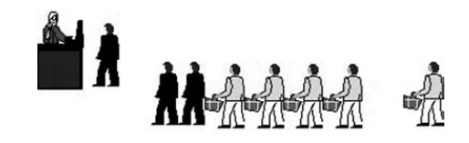
Animation Using different entity pictures for different types of entities
If it turns out that the first-class air passenger customer service process is not operating properly, it will be easy to see if coach-class passengers are being served instead.
This can help insure that the different types of entities go to the appropriate part of the model.

Slide 8
Animation Following the entities through the system
By following the animated entities through the model, it is possible to verify that the model logic is correct.
The most common example of this situation is one in which practitioners discover that a decision structure is improperly sending entities to various parts of the model.

Slide 9
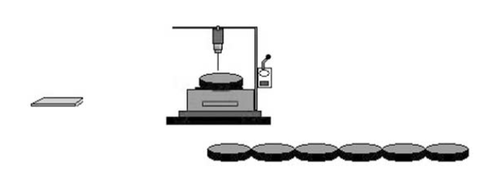
Animation Changing entities pictures
If a roll of raw material is cut into different sections by a machine, the entities that proceed from the machine should have a different entity picture than the roll of raw material.

Slide 10
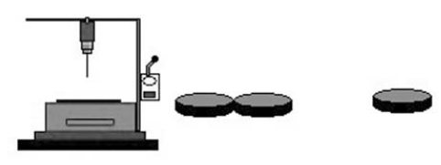

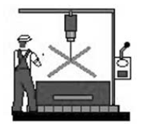
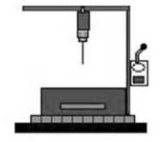
Animation Changing resource pictures
A very effective means of determining what is happening to the resources in a simulation model is to change the picture corresponding to different resource states. Colors may also be used to indicate the state of different resources.
A manufacturing machine could have the following system states:
Idle
Busy
Inactive
Failed

Slide 11
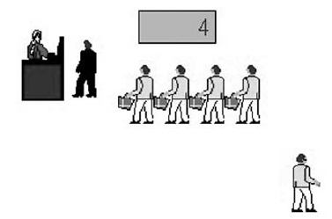
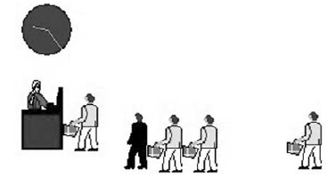
Animation Displaying global variables or entity attribute values
Instantaneous displays are particularly useful when used to display a variety of counter values located in different parts of the model.
Each time an entity enters a particular part of the model, the counter corresponding to that part of the model is incremented.
Instantaneous displays are also useful for illustrating the number of entities in a queue.
Simulation models can benefit from the use of an analogue display of the simulation time.

Slide 12
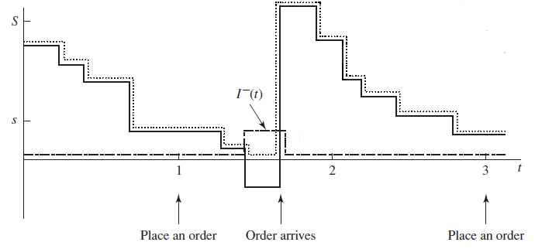
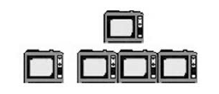

Animation Displaying plots of global variables or entity attributes
A digital or analogue animation display is limited to displaying a single value at any given moment.
When the value changes rapidly, it is difficult to keep track of the past values.
When the plots display unusual or unrealistic trends, the practitioner should investigate the model logic.

Slide 13
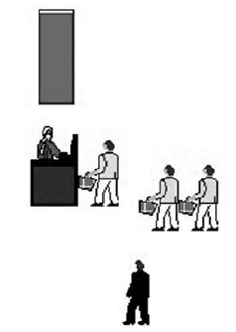
Animation Displaying Levels of System Statistics
Another type of animation that can help the practitioner debug a simulation model is the level.
If, for example, the practitioner wanted to know the running average utilization for a resource, a level could be used.

Slide 14
Advancing the Simulation Clock Event by Event
Although it is possible to slow significantly the animation of the model, it would be better to be able to step through the model event by event.
To allow practitioners to debug their models under controlled circumstances, most simulation software packages have VCR-like controls.
These allow the practitioner not only to step through the model but also to fast forward to the part of the model the practitioner is interested in viewing.

Slide 15
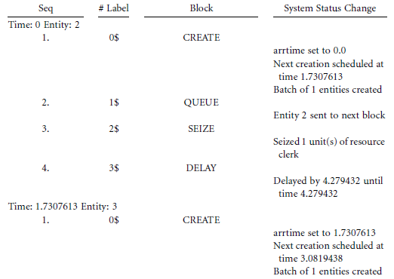
Writing to an Output File
Another potentially useful but more difficult to use verification tool is the use of output files.
In contrast to the use of an animation display, output files provide a permanent record for the practitioner.
Event List File :

